Slide 1
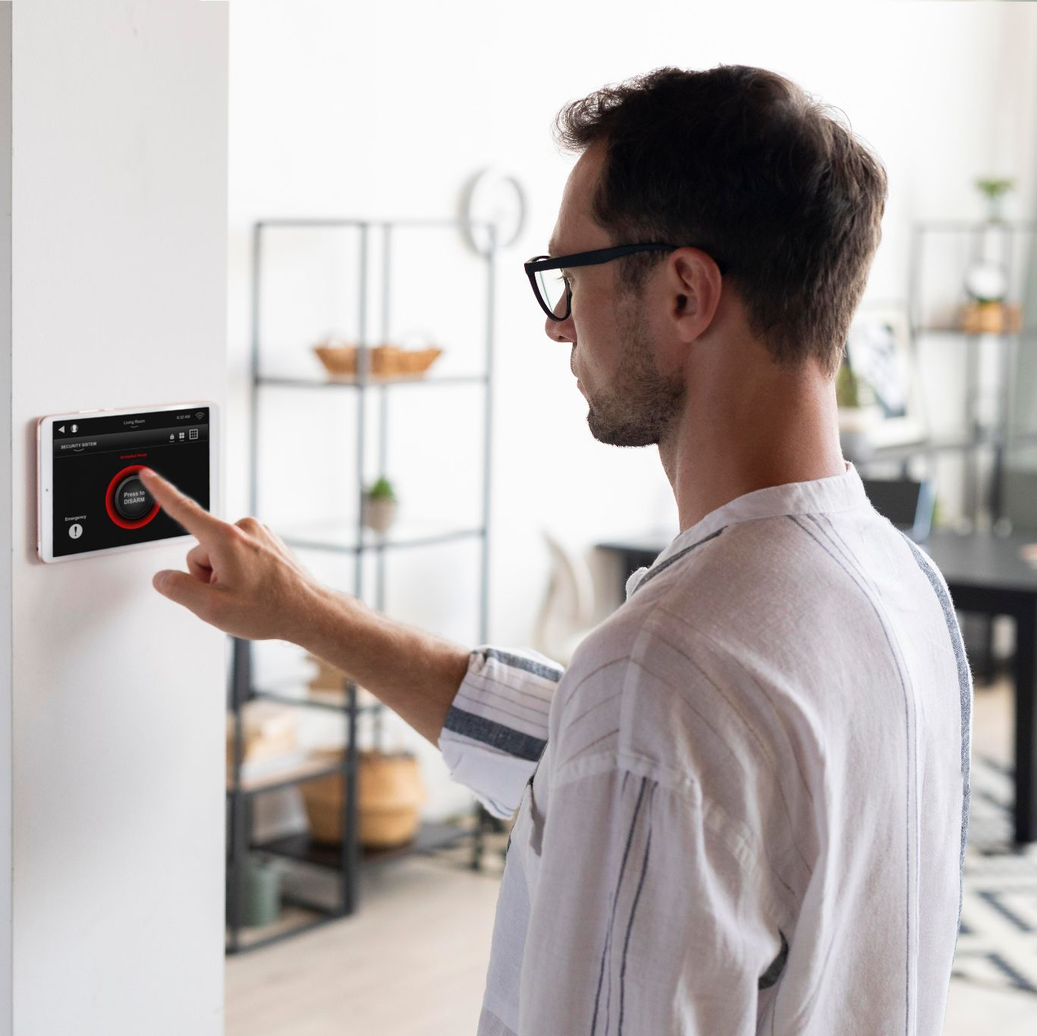
IOT-BASED SECURITY SYSTEM
Here is where our presentation begins

Slide 2
TABLE OF CONTENTS
01
INTRODUCTION
04
Hardware Details
02
05
PROBLEM DEFINATION
Advantages
03
Architecture
06
Conclusion
Overview of the system
Product Specification
Why is this system proposed?
Discuss some Key Feature of this project
Describes the architecture with central role of the broker and how clients communicate.
Summarizes the significance of This systems.

Slide 3
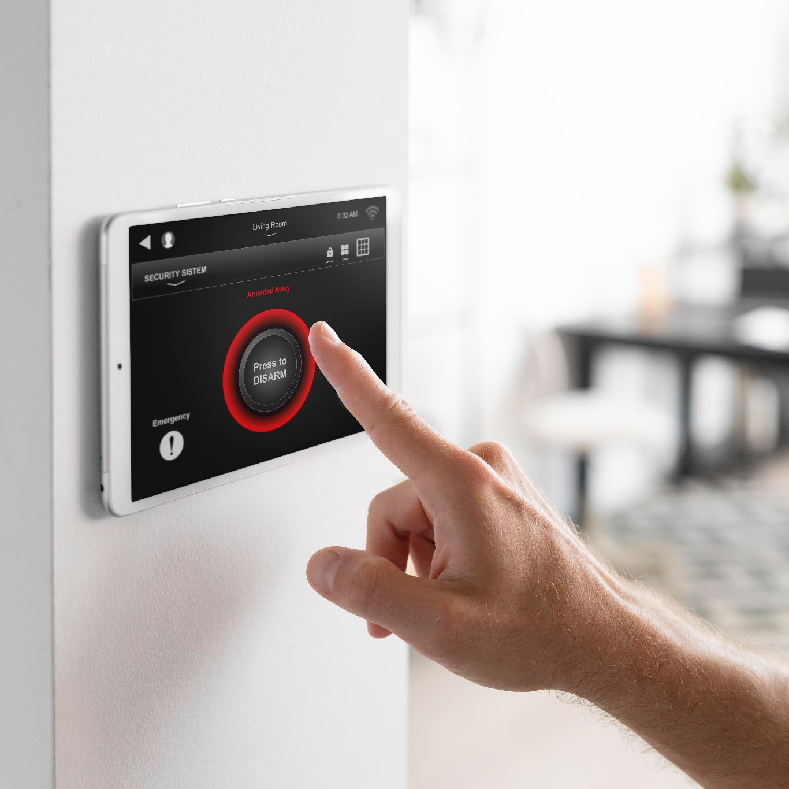
INTRODUCTION
Let’s begins…

Slide 4
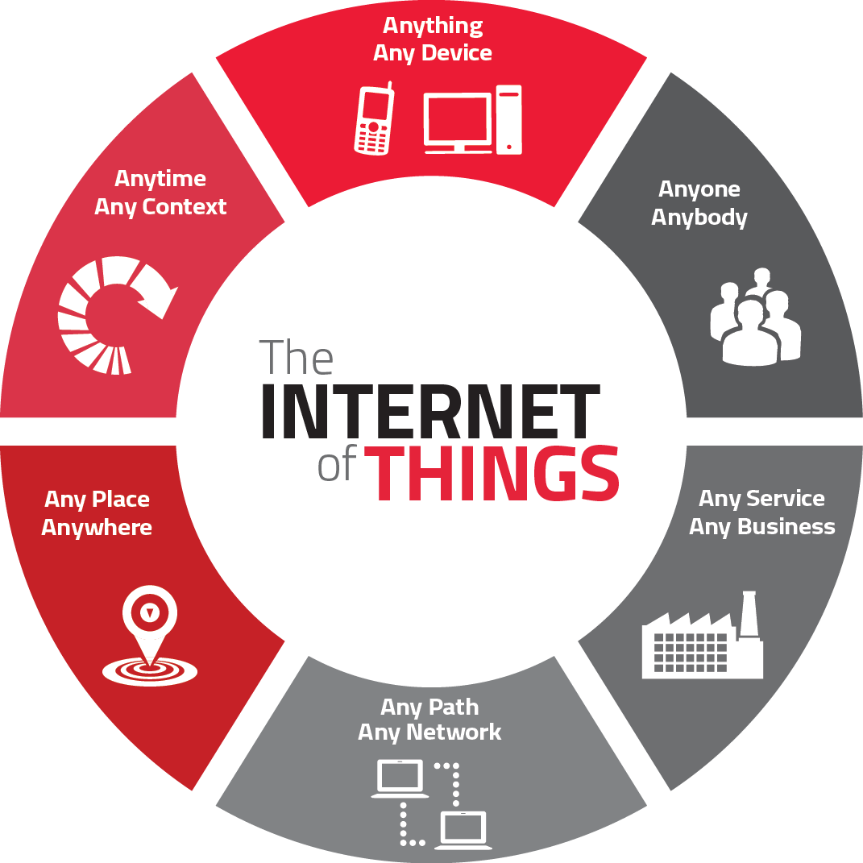
INTRODUCTION
What is a security system?
Why is security important in today's world?
Evolution of security systems ?
This Photo by Unknown Author is licensed under CC BY-SA

Slide 5

PROBLEM DEFINATION
Why is this system proposed?

Slide 6
PROBLEM DEFINATION
Lack of Real Time Monitoring
Fragmented Sensor Integration
Inadequate Environmental Hazard Detection
Limited Data Visualization & User Interaction
High Implementation Cost

Slide 7
How IOT Enhance Security
Real-time surveillance with ESP32-CAM
Instant alerts via MQTT & Telegram
Multiple authentication methods
Remote access and control via Node-RED
Data logs and visualization with Web interface

Slide 8
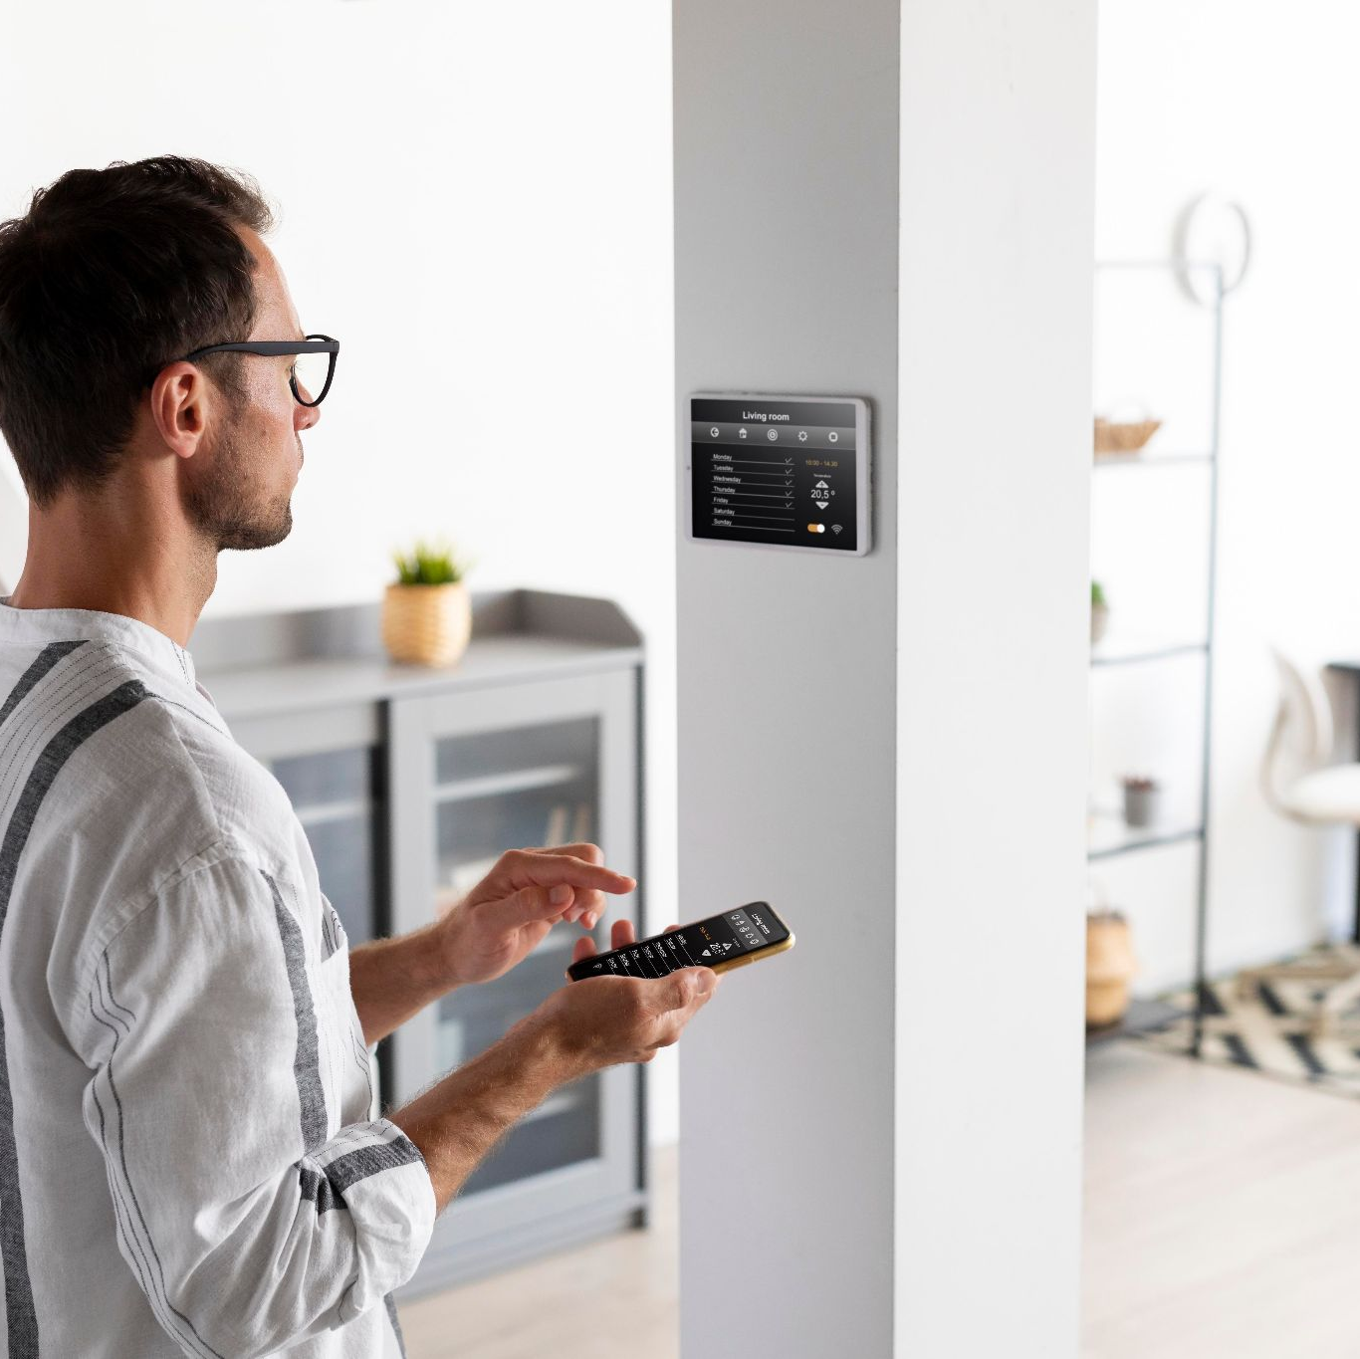
ARCHITECTURE
Flow of the Project

Slide 9
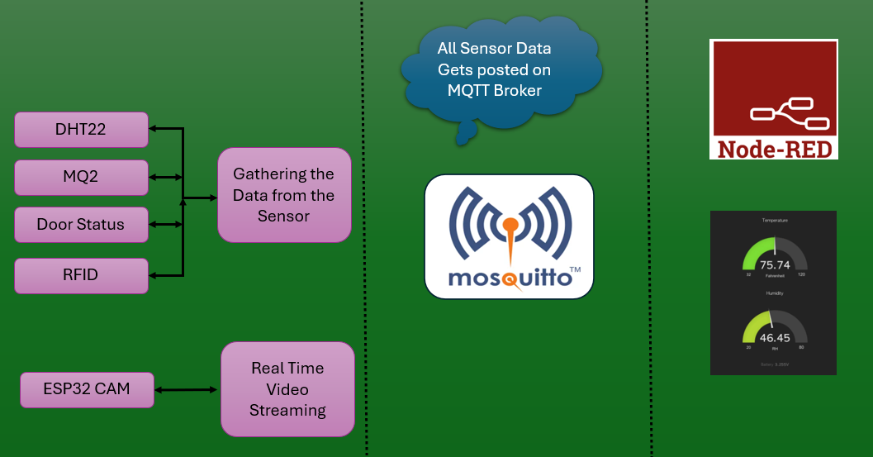
R307

Slide 10
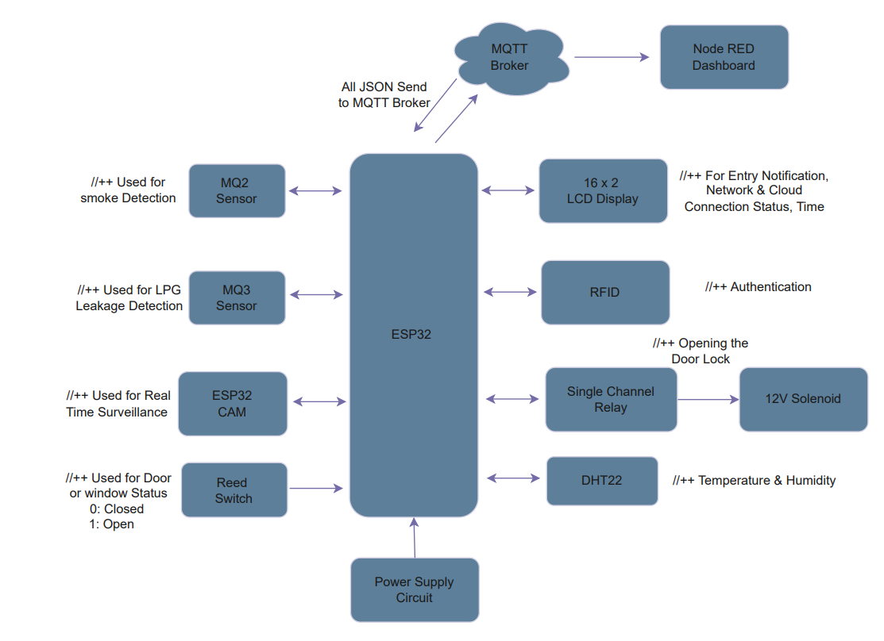

Slide 11
HARDWARE DETAIL
Product Specification

Slide 12
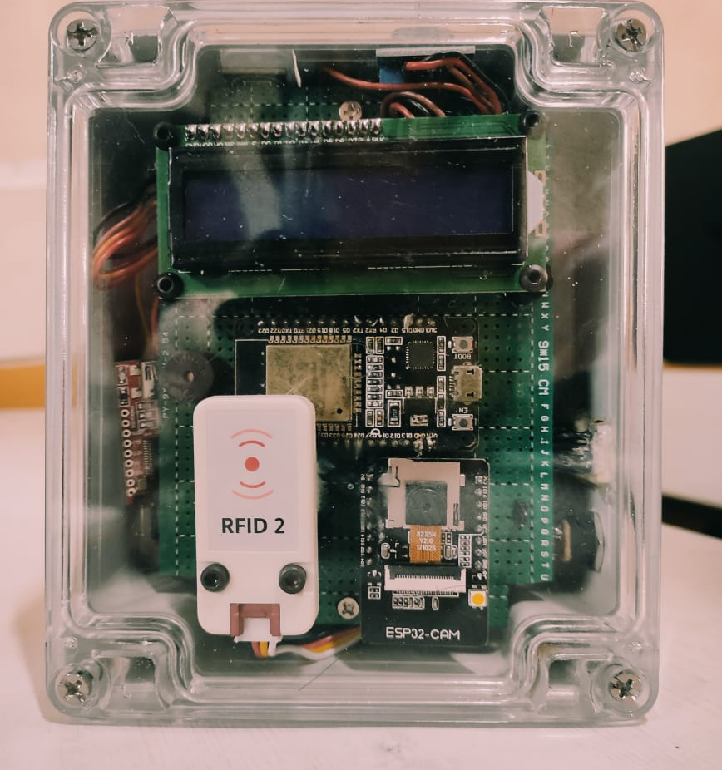
Temperature & Humidity(DHT22)
Smoke Sensor(MQ2)
16*2 LCD Display
ESP32 (Brain)
RFID Reader
ESP32 CAM (Real Time Surveillance)

Slide 13
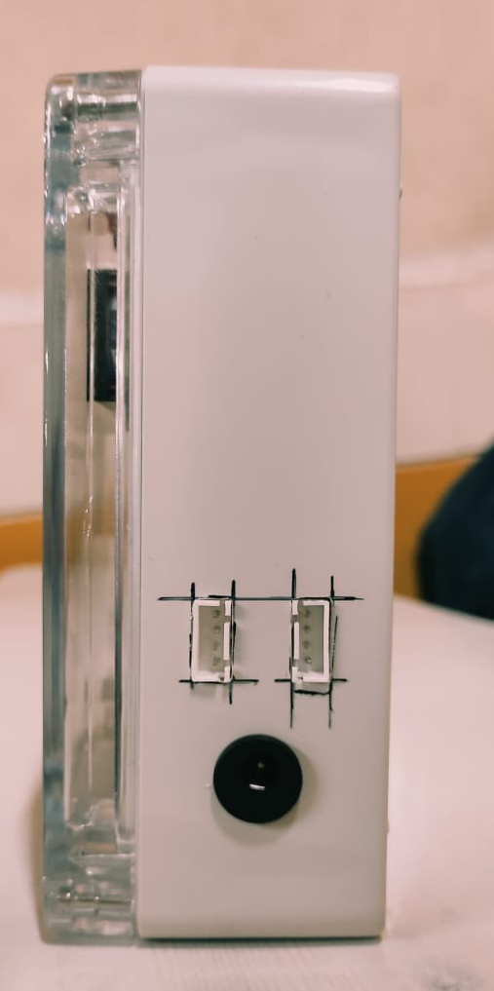
Fingerprint Sensor
Reed Switch & Solenoid Lock
Power supply Unit

Slide 14

ADVANTAGES
Advantages of IoT-Based Security System

Slide 15
KEY FEATURES
24/7 remote monitoring
Multi-layer authentication
Automated alerts and notifications
Cost-effective and scalable
Easy integration with smart home automation

Slide 16
CONCLUSIONS
Enhanced Security & Real-Time Monitoring
Automated Access Control & Authentication
Faster Incident Response with Smart Alerts
Remote Monitoring & Data Visualization

Slide 17
THANKS
Do you have any questions?
Rupeshthakur22@gmail.com
+91 9321738137

